Slide 1

QER - 4097
QER: BID 141KM SF300065C004.1X - Zeta wire weld crack

Slide 2
Pipe section / Details
Item | Traceability / identification
Project number | SF300065C004
Project name | BID 141KM
Pipe section | SF300065C004.1X
ST number | ST101.51896
Affected layer / equipment | Spiralling
Length affected | 4618.3m
Drawing number / MP code / STA / Dimension | Zeta wire 6.2 (MP205)

Slide 3
Overview of anomaly
Problem Description :-
During the zeta spiraling process for BID 141KM SF300065C004.1X (ST10151896), the welds crack was detected at length 4619.3m and 5080.9m during weld inspection after it was laid on the pipe.
Note that, these affected welds are welds from winding.
Details of the defective welds are as the following: -
1st weld at length 4618.3m - Weld No: 29-6
Bobbin no: 003
Welding machine: BS13-12
2nd weld at length 5080.9m - Weld No: 14-6
Bobbin no: 003
Welding machine: BS13-12
Root Cause :-
The possible root causes for zeta weld crack were due to:
1) Misalignment (High localized stress).
2) Oil presence on the wire (the primary source of Hydrogen).
Machine setting root cause is ruled out based on graph comparison of crack weld and subsequent weld. No anomaly was found.
Problem Handling:-
The defective welds were rejected according to DP-QCP-08DAQT001. Therefore, the un-spiraling was then performed to remove the defective welds.
In addition, based on DI-IND-MET1075, the (N-1 and N+1) for these 2 welds cracks have been retrieved and tested for tensile test. The results of the tensile test for these 2 welds were accepted.

Slide 4
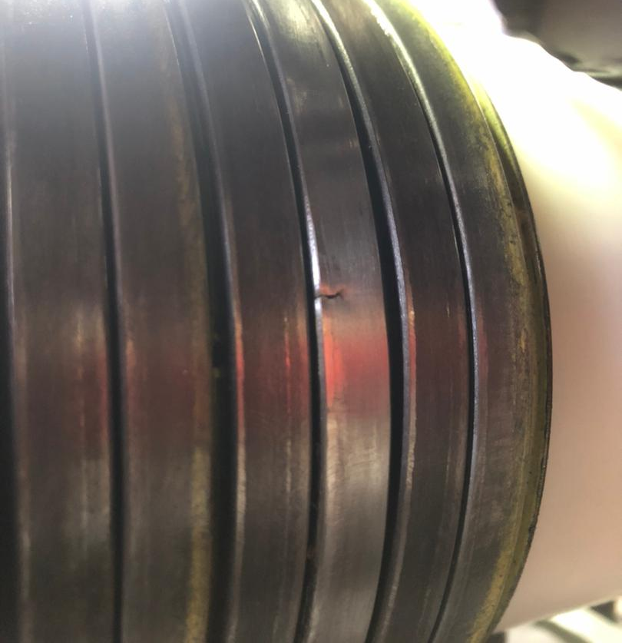
Wire crack length 4619.3m photo
Figure 1 : Weld crack was detected at length 4618.3m during weld inspection after it was laid on the pipe..

Slide 5
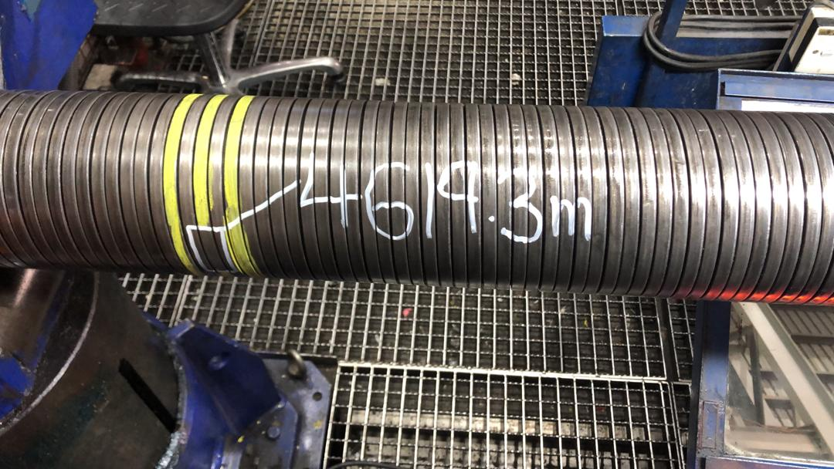
Repaired 4619.3m Photo
Figure 1 : Replaced with weld 21-4 from (BS13-11)

Slide 6
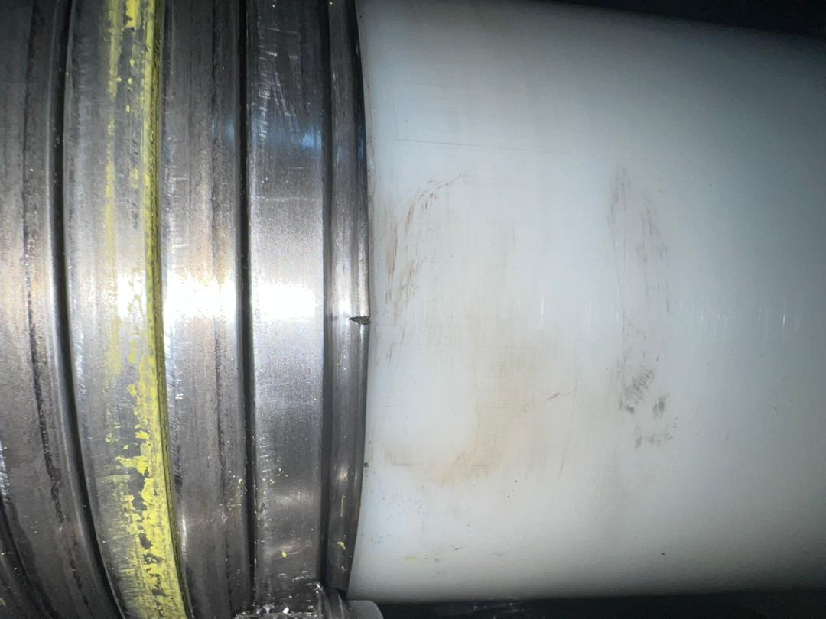
Wire crack length 5080.9m photo
Figure 3 : Weld crack was detected at length 5080.9m during weld inspection after it was laid on the pipe..

Slide 7
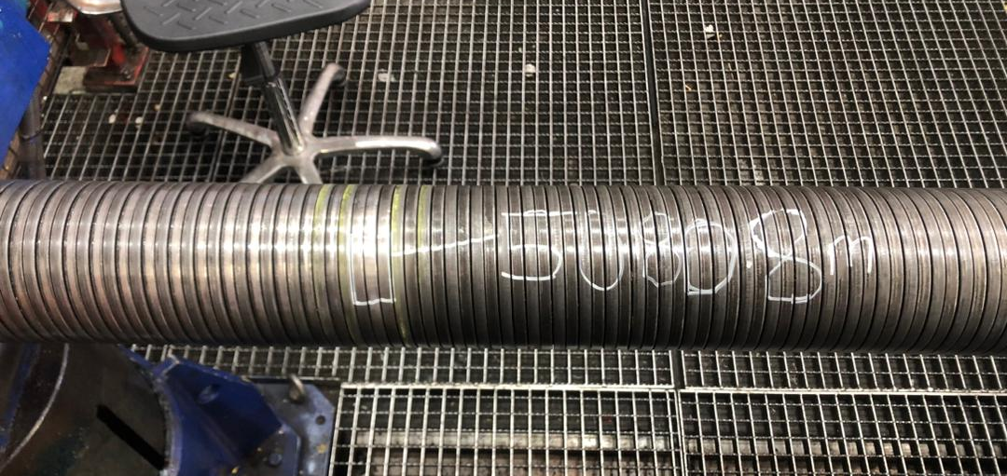
Repaired 5080.9m Photo
Figure 4 : Replaced with weld 24-04 from (BS13-11)

Slide 8

THANK YOU

